Slide 1

GadgetHub
A Frontend Marketplace for Buying & Selling Gadgets
prepared by
Uday Chauhan
01

Slide 2
Table of content
1.Introduction – Overview of GadgetHub and its purpose
2.Problem Statement – Identifying the need for an improved gadget marketplace
3.Project Objectives – Key goals and intended impact of GadgetHub
4.Features – Overview of core functionalities and user experience
5.Technologies Used – Frontend technologies and design principles
6.UI Design & Wireframes – Visual representation of key pages
7.Challenges & Solutions – Development obstacles and their resolutions
8.Future Enhancements – Potential upgrades and feature expansions
9.Conclusion – Summary of the project and key takeaways

Slide 3
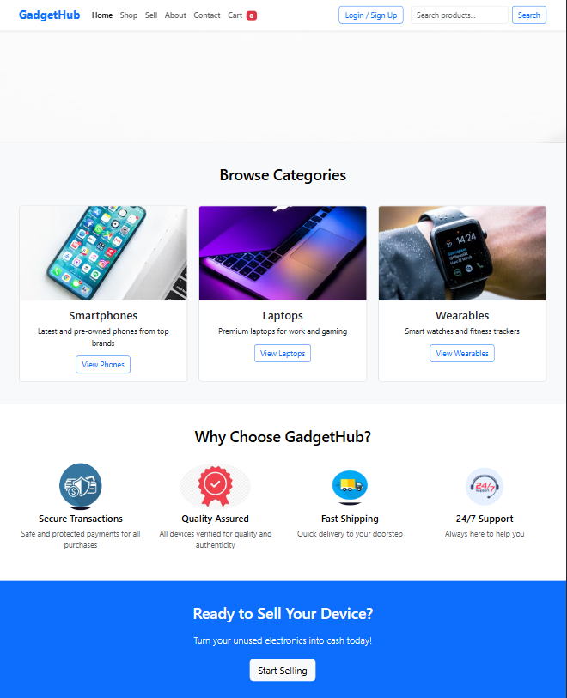
03
Introduction
GadgetHub is a frontend web platform for buying and selling gadgets like mobiles, laptops, and wearables. Built with HTML, CSS, JavaScript, and Bootstrap, it ensures a modern, responsive, and user-friendly experience with seamless navigation and product browsing
Business Proposal | Oddball Imaging Studio

Slide 4

Problem Statement
Problem 1
04
High costs reduce accessibility and limit user participation.
Problem 2
Complicated user interfaces make the shopping experience difficult.
Problem 3
Cluttered layouts overwhelm users, making navigation and product discovery inefficient.

Slide 5
05
Solutions
SOLUTION-1
SOLUTION-2
SOLUTION-3
GadgetHub ensures affordable trading by eliminating high fees, enhancing accessibility, and boosting user participation.
GadgetHub offers a streamlined interface, simplifying navigation and enhancing the shopping experience
GadgetHub ensures a clean, organized layout, improving navigation and product discovery.

Slide 6
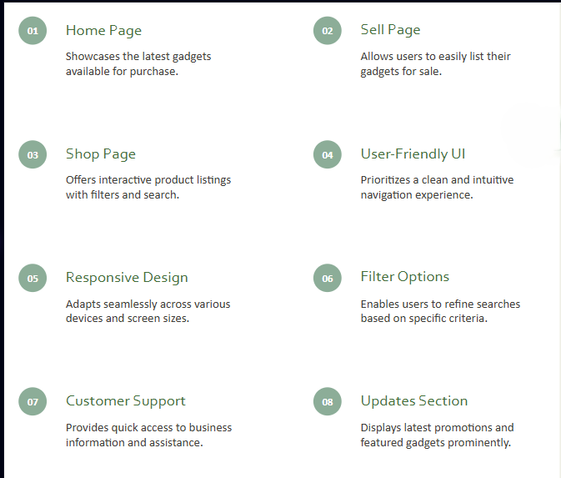
06
Features

Slide 7
07
Technologies Used
1
FRONTHAND TECHNOLOGIES
HTML ,CSS, JAVASCRIPT
DESIGN FRAMEWORK
BOOTSTRAP
2
3
JAVASCRIPT
UI/UX PRINCIPLE

Slide 8
Future Enhancement
08
DATABASE
Develop a robust database for improved
service
PAYMENT
Implement secure payment integration for transaction
AUTHENTICATION
Enable user authentication of secure environment
MOBILE
Launch Mobile app for on-the-go acces
SEO
Enhance website SEO for better visibility and reach
MARKETING
Implement marketing strategies to grow user base

Slide 9



09
USER-FRIENDLY INTERFACE
GadgetHub features a clean and intuituve design for easy navigation
RESPONSIVE DESIGN
Conclusion
Compelling technology ensure full accessbility across all the devices
FUTURE DEVELOPMENT PLANS
GadgetHub aims to enhance capabilities with backend and payment features

Slide 10
10
MAILING ADDRESS
LJ University ,SANAND ,ADMEDABAD ,382430
Contact us
EMAIL ADDRESS
uday0408@gmail.com
PHONE NUMBER
+91 6351334613

Slide 11

Thank you

